Slide 1

Unsupervised Learning

Slide 2
Unsupervised Learning
Unsupervised learning is a branch of machine learning where models are trained on unlabelled datasets without predefined output labels. Unlike supervised learning, which focuses on predicting specific outcomes, unsupervised learning algorithms aim to uncover patterns, relationships, or hidden structures within the input data. Common applications include clustering and dimensionality reduction. In essence, it's about discovering meaningful insights from data without prior knowledge of expected results.

Slide 3
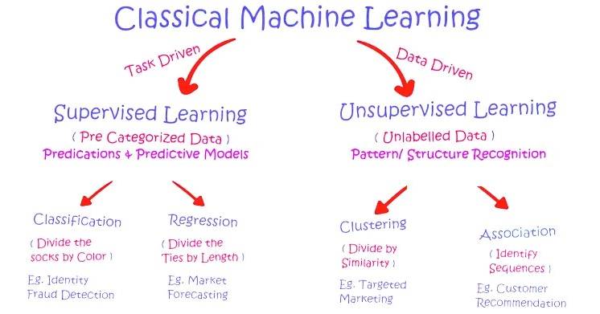

Slide 4
No Labelled Data
Unsupervised learning is characterized by its independence from labelled data. Algorithms in this category do not depend on predefined output labels, allowing them to explore and analyse raw input data without any prior knowledge of correct output values. This absence of labelled data enables unsupervised learning models to derive insights and patterns directly from the input data itself.

Slide 5


Algorithms
Common algorithms used in unsupervised learning include k-means clustering, hierarchical clustering, principal component analysis (PCA), dimensionality reduction techniques like t-SNE, and association rule learning algorithms such as Apriori.

Slide 6

Dimensionality Reduction
Dimensionality reduction is a fundamental task in unsupervised learning that centers around streamlining complex datasets by diminishing the number of features or variables, all while retaining vital information for analysis. This simplification is instrumental in facilitating data visualization and in-depth examination. Dimensionality reduction techniques can either be linear or nonlinear and are commonly deployed in a range of applications, including image and speech recognition, signal processing, and data compression.

Slide 7
Dimensionality Reduction
Noteworthy methods for dimensionality reduction encompass principal component analysis (PCA), t-distributed stochastic neighbor embedding (t-SNE), and autoencoders. In essence, dimensionality reduction is a technique that contributes to simplifying intricate data within unsupervised learning contexts.

Slide 8

Pattern Discovery
Unsupervised learning's core objective is pattern discovery, entailing the identification of hidden patterns, correlations, and structures within the data. This process involves revealing inherent relationships between variables without prior knowledge. The assessment of unsupervised learning models primarily hinges on their capacity to unveil meaningful patterns or structures in the data, rather than making explicit predictions. This approach serves to simplify data analysis and aids in understanding the underlying relationships among data points.

Slide 9
Clustering
Clustering is a prevalent unsupervised learning task that involves organizing data points into groups based on their shared characteristics. This process helps unveil inherent patterns or groupings in the data and is valuable for tasks such as customer segmentation, image and text classification, and anomaly detection. Common clustering algorithms used for this purpose include k-means clustering, hierarchical clustering, and DBSCAN. Essentially, clustering aids in identifying natural data groupings or segmentation.

Slide 10
Applications of Unsupervised Learning
Anomaly Detection
Customer Segmentation and Behavioural Analysis
Recommendation Systems
Image and Video Data Compression
Natural Language Processing (NLP)

Slide 11

Anomaly Detection
Anomaly detection is a vital application of unsupervised learning, as it enables the identification of atypical patterns within various datasets, whether it's network traffic, financial transactions, or system behaviour. The focus is on pinpointing data points that significantly deviate from the norm. This capability is essential for tasks such as fraud detection, intrusion detection, and any context where the recognition of rare or abnormal events is paramount.

Slide 12

Anomaly Detection
Anomaly detection methods can be either unsupervised or supervised, utilizing statistical models, machine learning algorithms, or a combination of both. Notable algorithms for anomaly detection include the isolation forest, one-class SVM, and local outlier factor (LOF).

Slide 13

Customer Segmentation and Behavioural Analysis
Enterprises employ unsupervised learning to categorize customers according to their buying habits, enabling the customization of marketing tactics for distinct customer groups.

Slide 14

Recommendation Systems
Unsupervised learning methods scrutinize user actions and inclinations to offer product, movie, or content recommendations, elevating user satisfaction across platforms such as e-commerce and streaming services.

Slide 15

Image and Video Data Compression
Methods like clustering and dimensionality reduction play a pivotal role in downsizing images or videos, all the while conserving their fundamental characteristics. This facilitates resourceful storage and transmission.

Slide 16

Natural Language Processing (NLP)
Unsupervised learning techniques find application in tasks like topic modelling, involving the analysis of extensive text data to unearth prevalent themes without the need for labelled examples.

Slide 17
Summary
Unsupervised learning is a highly valuable tool that empowers machines to discern inherent structures and relationships within data, making it indispensable for various data analysis tasks. It excels at revealing concealed patterns, rendering data more digestible, and enabling better interpretation. By harnessing unsupervised learning techniques, one can acquire valuable insights and make informed decisions across a broad spectrum of applications.

Slide 18
Summary
Key algorithms in unsupervised learning encompass k-means and hierarchical clustering, principal component analysis (PCA), dimensionality reduction methods such as t-SNE, and association rule learning for uncovering variable relationships. In essence, unsupervised learning is a versatile approach within the realm of machine learning, adept at exploring data without explicit guidance.

Slide 19
Summary
This approach plays a vital role in comprehending intricate data patterns, proving instrumental in various real-world scenarios, particularly when labelled data is limited or absent. It is instrumental in many machine learning applications, particularly those involving data exploration and unsupervised data analysis.

